Slide 1
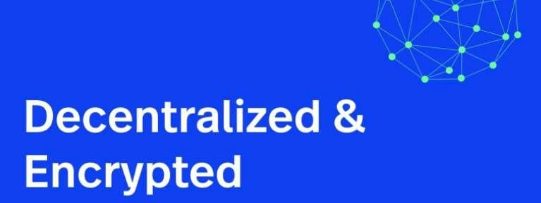

Decentralized Web Hosting
By
Abhishek Tripathi
1709010003
B.Tech (C.S.E.)

Slide 2
Team Members
Abhishek Tripathi (Roll No:- 1709010003)
Divya Darshan (Roll No:- 1709010032)
Aditya Nath (Roll No:- 1709010007)
Himanshu Yadav (Roll No:- 1709010040)

Slide 3
Agenda
Centralized Internet’s Problems
What is Decentralized Internet
How Decentralized Internet Works
The Hurdles to Be Cleared
Examples
The Future

Slide 4
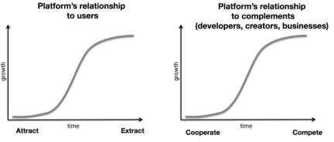
Centralized Internet’s
Problems
Relatively few large, physical servers (associated or operated by relatively few large corporations) are responsible for hosting essential elements of what we consider the internet. These web hosting and cloud computing servers are responsible for keeping our email, social media, and webpages available to all — and that means that the companies that own those servers have an outsized impact on how the internet runs.
Few major vulnerabilities that will likely only get
worse in the near future
Servers Can Go Down
Servers Can Be Hacked
Companies Throttle or Censor Data
Companies Monetize Your Data
Problem of network governance
In the 21st century, a lack of personal privacy is just the new normal. But it doesn’t have to be.
The best entrepreneurs, developers, and investors have become wary of building on top of centralized platforms

Slide 5
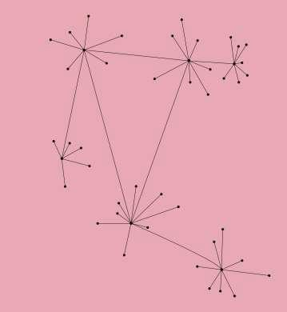
What is Decentralized Internet
Decentralized simply mean you and I can host the nodes (servers) and still we can’t peek what’s getting stored or processed inside our nodes as its all encrypted and a p2p protocol is ensuring the security and integrity of the data being passed around.
The vision is to replace today’s existing server centric and intrusive systems with a fully decentralized and trustless network made up by the individual users who contribute storage, computing power and bandwidth to form a world-wide autonomous system.
The technology that’s getting renewing excitement in the decentralized internet in 2018 is Blockchain.
A blockchain protocol is designed to allow transactions across a distributed network without the need for a broker overseeing the process. Any information can be observed by anyone, and is encoded in a way that won’t let anyone mess with it.
A decentralized application (Dapp, dApp or DApp) is an application that is run by many users on a decentralized network with trustless protocols. They are designed to avoid any single point of failure.

Slide 6
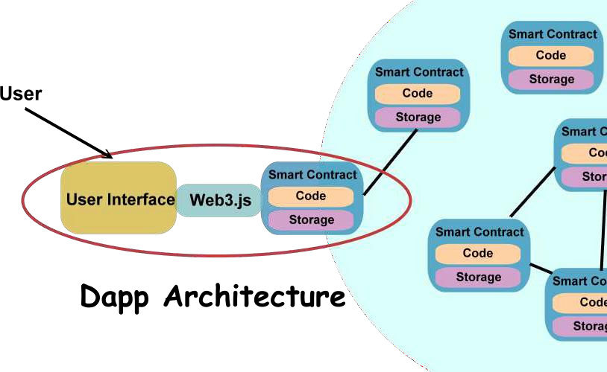
A decentralized version would rely on a peer-to-peer network built on a community of users. Their internet- connected devices would host the internet, not a group of more high- powered servers. Each website would be spread out across hundreds of nodes on different devices, erasing the possibility of a single server crashing due to, say, a DDoS attack.
People using mobile devices do not know how much of their bandwidth lies idle and is never used. decentralized Internet will make use of this bandwidth to provide Internet to everyone who signs up for it. The current Internet will be used just a stub so that people can launch the decentralized Internet and then go worry free.
To put it in one line, you as a user will be both a client and a server. Your devices’ will make use of idle bandwidth on other connected mobile devices and in return, will provide bandwidth of your device to others. There won’t be possibilities of hacking even though the devices will be interconnected.
How Decentralized Internet
Works

Slide 7
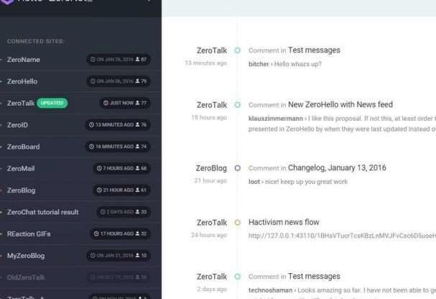
Examples - Zeronet
ZeroNet launched that aims to deliver a decentralized web platform using Bitcoin cryptography and the BitTorrent network.
ZeroNet uses a combination of BitTorrent, a custom file server and a web based user interface to do so and manages to provide a pretty usable experience. The main goal of this project is to host websites and provide anonymity for each site’s owner.
.BIT DOMAINS: Decentralized domains
using Namecoin cryptocurrency.
ANONYMITY: You can easily hide your IP address using the Tor network.
OFFLINE: Browse the sites you're seeding even if your internet connection is down.

Slide 8
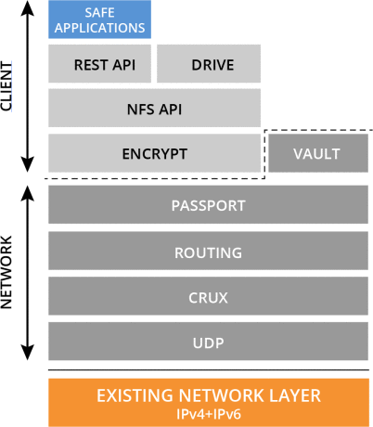
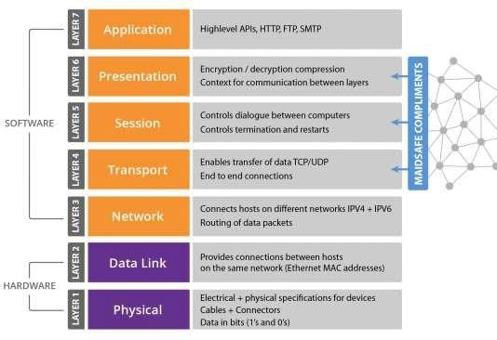
Example: Maidsafe
MaidSafe — Massive Array of Internet Disks - Secure Access For Everyone. Maidsafe is an open-source program (hosted on GitHub) that enables a decentralized Internet platform.
The key part of MaidSafe is its SAFE network, powered by its participants' computers, which means, instead of specialized servers, data are stored and distributed by a network of internet-connected computers.
Anyone running MaidSafe program will become part of the SAFE Network. The MaidSafe system turns all connected devices into SAFE Network nodes that collectively store data for all MaidSafe users.
Data storage is automatically decentralized, which means a web application using MaidSafe does not store its user's data on any central server — rather the data is spread across many disks and devices owned and managed by many different MaidSafe users. Therefore, no one, whether it’s person or corporation, has an intact copy of a user's file.
Safecoin. The mechanism that incentivises the provision of resources by the network,
measuring and rewarding value without wasting any resources (no proof of work).

Slide 9
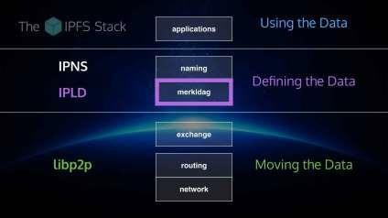
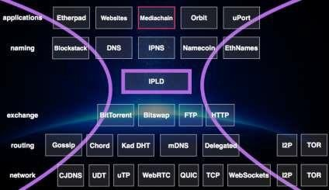
Example : IPFS
Interplanetary File System, or IPFS, is an open source project that taps into ideas pioneered by the decentralizeddigital currency Bitcoin and the peer- to-peer file sharing system BitTorrent. Sites opt in to IPFS, and the protocol distributes files among participating users. If the original web server goes down, the site will live on thanks to the backups running on other people's computers. What's more, these distributed archives will let people browse previous versions of the site, much the way you can browse old edits in Wikipedia or old versions of websites in the Wayback Machine.
You need to have IPFS's software installed on your computer to take part. But Benet says the team has already built a version of the software in JavaScript that can run in your browser without the need to install any new software at all. If it winds up on everyone's browsers, the idea goes, then everyone can help back up the web.

Slide 10
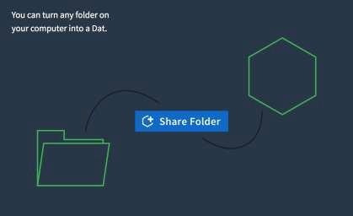
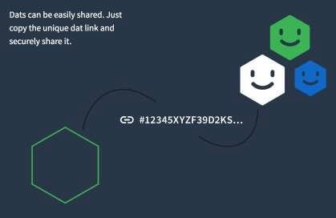
Example: Dat Ptoject
Dat is a nonprofit-backed data sharing protocol for applications of the future.
Dat is a new p2p hypermedia protocol. It provides public-key-addressed file archives which can be synced securely and browsed on-demand.
By Improving speeds while using less bandwidth the Dat Protocol makes it the default by using a peer-to-peer network and seamlessly add or remove hosts as needed.
Data is deduplicated between versions, reducing bandwidth costs and improving speed. Developers can create custom storage that work over a variety of protocols.
Beaker: a decentralized, peer-to-peer web browserthat lets you createand fork websites
Private Sharing: share files privately, encrypted with the secret URL.

Slide 11
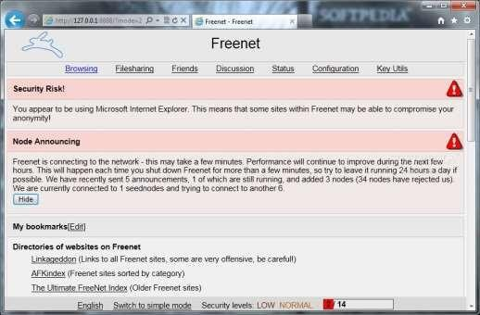
Example: Freenet
Freenet is a peer-to-peer platform for censorship-resistant communication. It uses a decentralized distributed data store to keep and deliver information, and has a suite of free software for publishing and communicating on the Web without fear of censorship.
Freenet is different from most other peer-to-peer applications, both in how users interact with it and in the security it offers. It separates the underlying network structure and protocol from how users interact with the network; as a result, there are a variety of ways to access content on the Freenet network. The simplest is via FProxy, which is integrated with the node software and provides a web interface to content on the network.
While Freenet provides an HTTP interface for browsing freesites, it is not a proxy for the World Wide Web; Freenet can be used to access only the content that has been previously inserted into the Freenet network. In this way, it is more similar to Tor's hidden services than to anonymous proxy software like Tor's proxy.

Slide 12
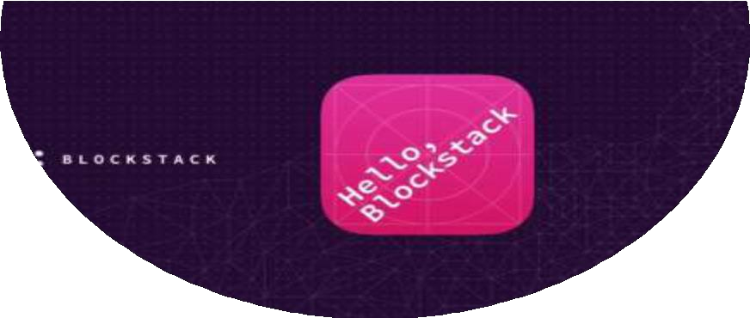
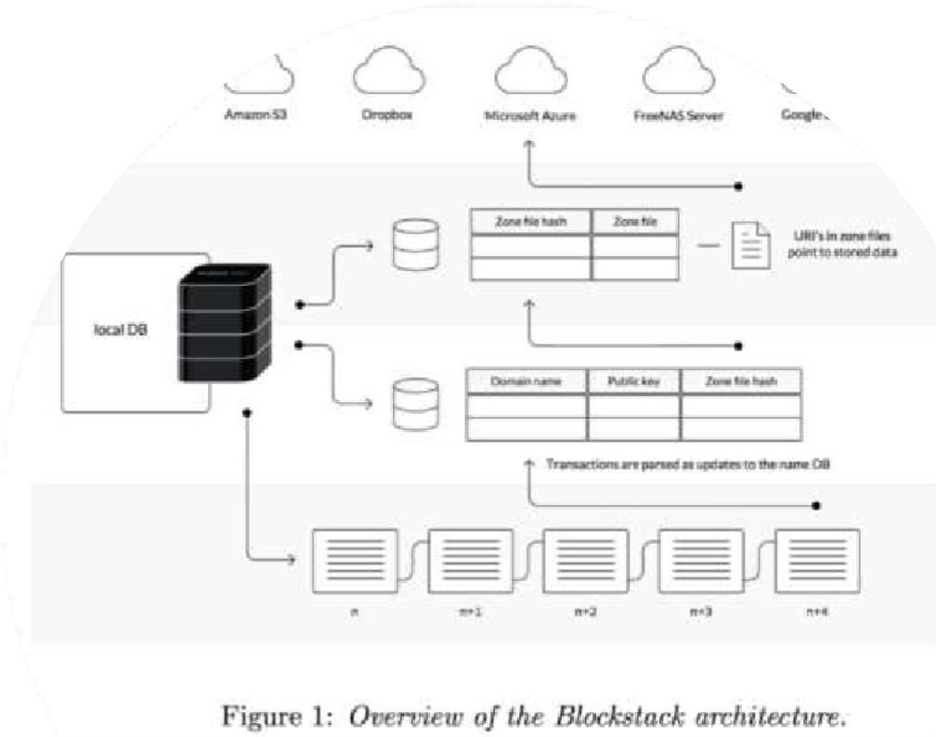
Example: Blockstack
Blockstack is an open source project ($50M recent ICO) that provides you a browser (called portal) to access the information stored on the decentralized web.
Blockstack works on existing TCP/IP networks, however, it doesn’t use centralized DNS providers. Instead, it stores its DNS indexes on multiple existing blockchains (such as Ethereum) eliminating the need of centralized servers that are prone to attacks and failures.
Blockstack has developed an API layer called gaia that remembers and ensures the integrity of the user permission/data to access.
There are virtual blockchains on top other blockchains that handle the complex logic computation of the applications, storing only the minimum and required data to the Ethereum etc.
Blockstack ensures that you are the owner of the file you are claiming to be? A new identity structure. They ask you to register a new identity on the blockstack using .ID extension. Once you register that <yourname>.id on the blockstack, you can use the same identity on all the apps built on top of blockstack. Even if you don’t register, you can use a hash to identify yourself.

Slide 13

Few challenges still stand in the way of a worldwide shift to the decentralized flavor of internet.
Adaption
Latency Problems
Users Don’t Want the Extra Responsibility
The decentralized internet remains a niche interest closely allied with the idiosyncratic world of cryptocurrencies
The Hurdles to Be Cleared

Slide 14
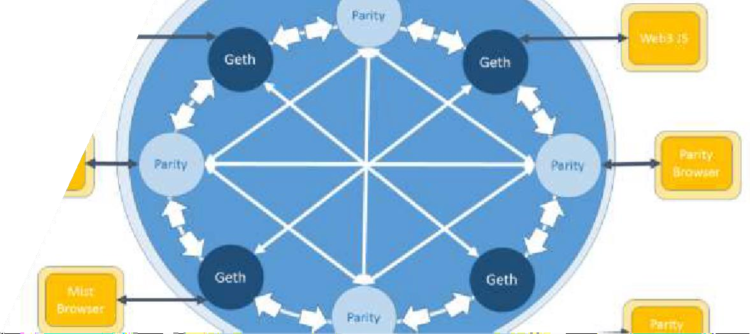
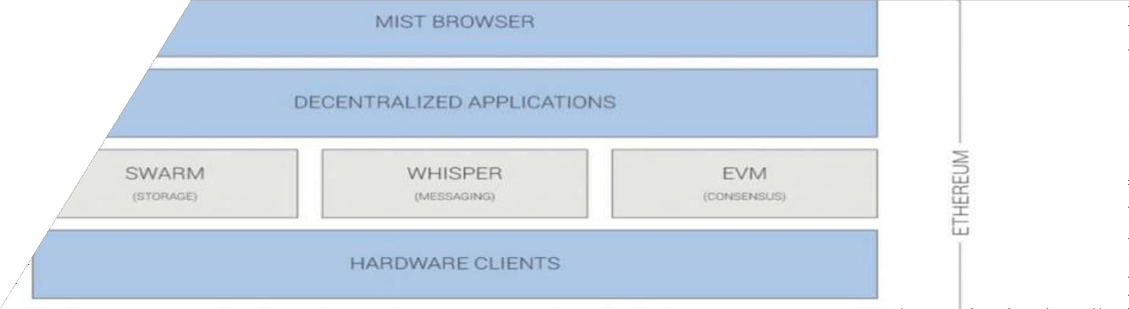
Example: Ethereum
The Ethereum project was, and is, one of the Internet's most intriguing and inspiring experiments. It all begun back in 2013, when researcher and prodigy programmer, Vitalik Buterin, proposed a way to generalize the concept of the Bitcoin Blockchain, transforming it from a decentralized bookkeeping ledger into a turing
complete virtual machine, or "World Computer", with the intention
to run applications, websites and even entire organizations, without having to rely on server farms, as it is the case today.
Similarly to the modern Internet, Ethereum has many different components in order for it to work properly. Some of the components of Ethereum are as follows:
Accounts
Validators (or so-called “miners”)
Blockchain ledger
Ethereum Virtual Machine (EVM)
Browser (for DApps)
Clients
Full nodes

Slide 15
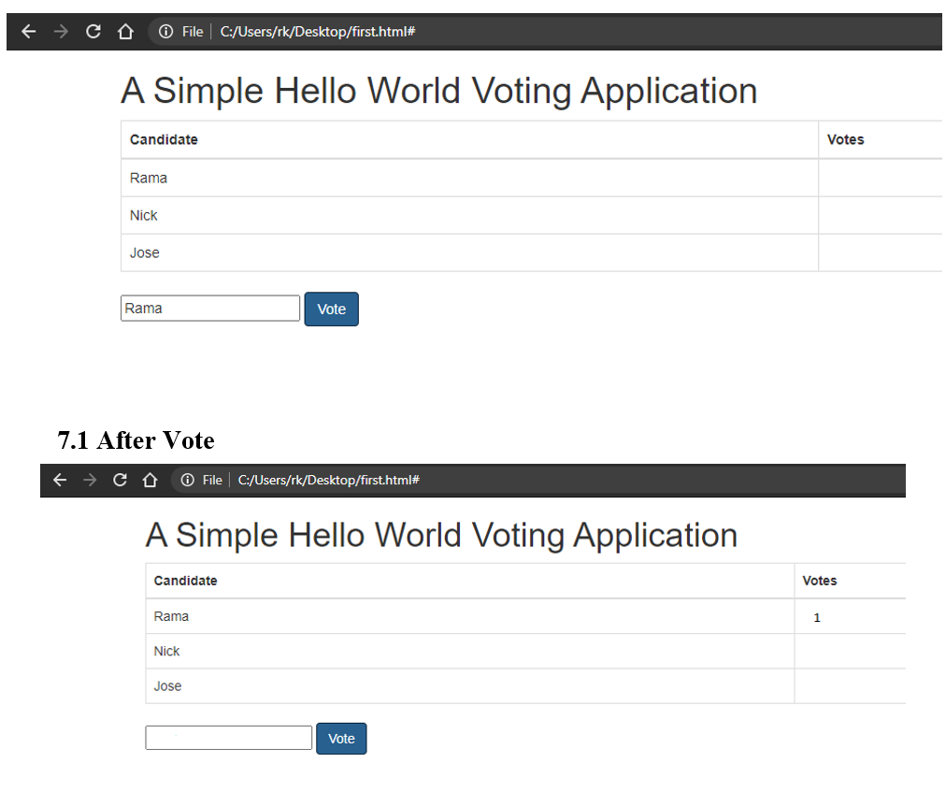

Slide 16
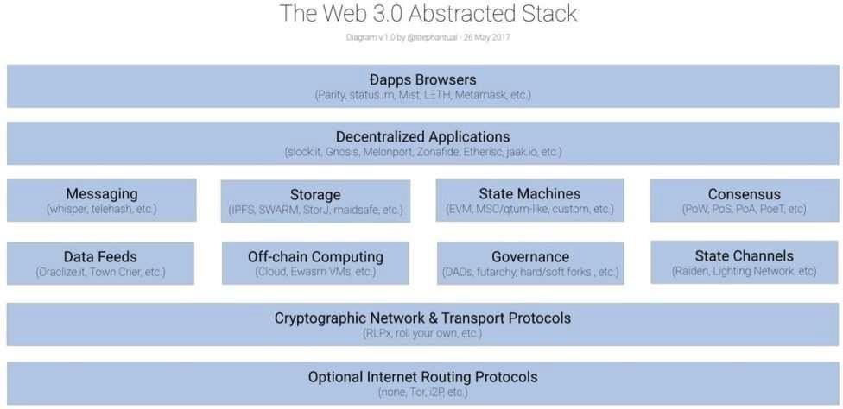
Conclusion
“Web 3”— the third era of the internet
On the vision of better decentralized web envisions, users control where their data is stored and how it's accessed.
Cryptocurrency & Decentralized Internet are intriguing methods of deregulating an essential aspect of modern life and they share the same DNA.
Decentralized networks aren’t a silver bullet that will fix all the problems on
the internet. But they offer a much better approach than centralized systems.

